Slide 1
WiFi hacking
李捷

Slide 2

Outline
1
Introduction
2
Wireless driver
3
Kernel module
Kernel debugging

Slide 3
1 Introduction
This talk will cover the following:
Wireless driver architecture in Linux
Code flow of 80211 packet in the kernel
Examples about kernel programming
Hacking WiFi with modifying AIFS,CW and Clear Channel Assessment(CCA) level.

Slide 4
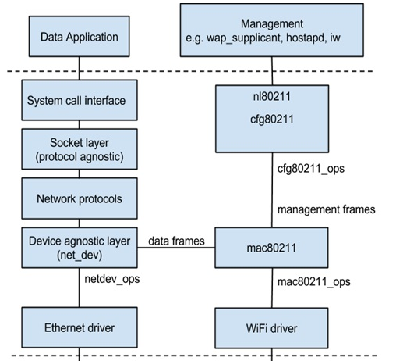
2 Wireless driver
Network Architecture:
Data plane
Control plane
User space
Kernel
space

Slide 5
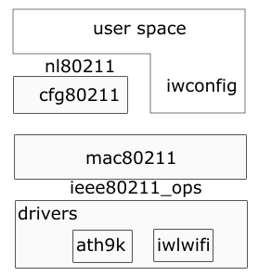
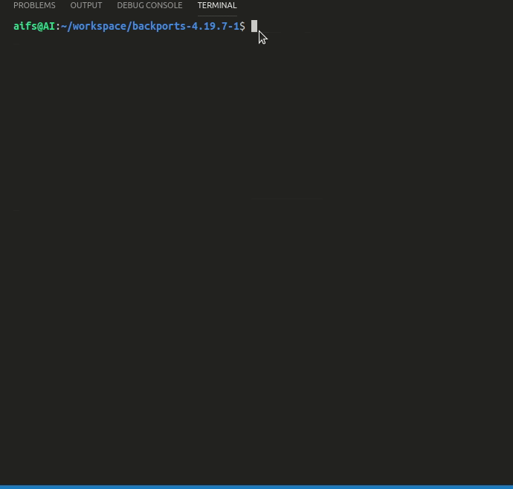
2 Wireless driver
User space Example

Slide 6
2 Wireless driver
The higher layer packet will be
converted to IEEE 802.11 frame format.
Function pointer interface.
Interface implementation.

Slide 7
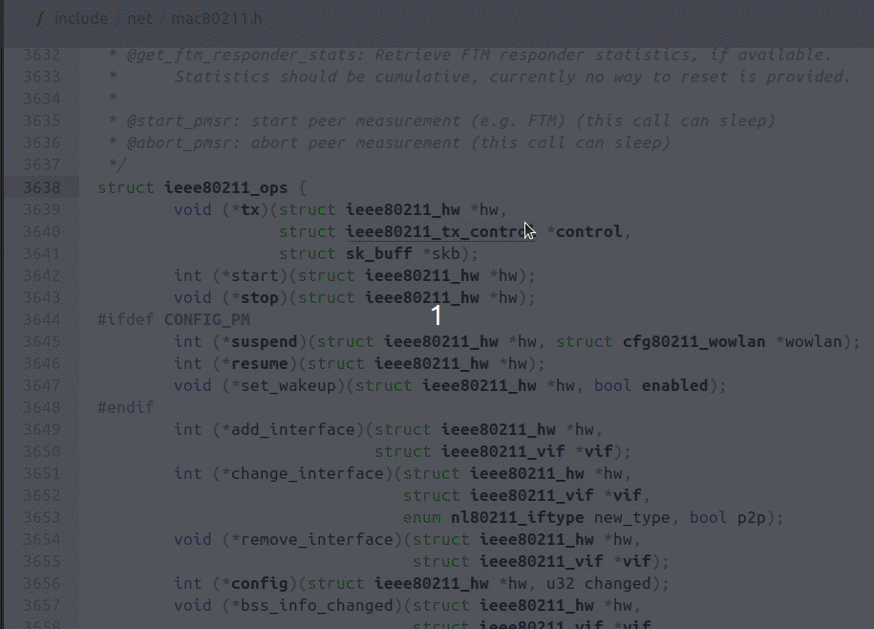
2 Wireless driver
Code Flow :
AIFS;
CW ;

Slide 8
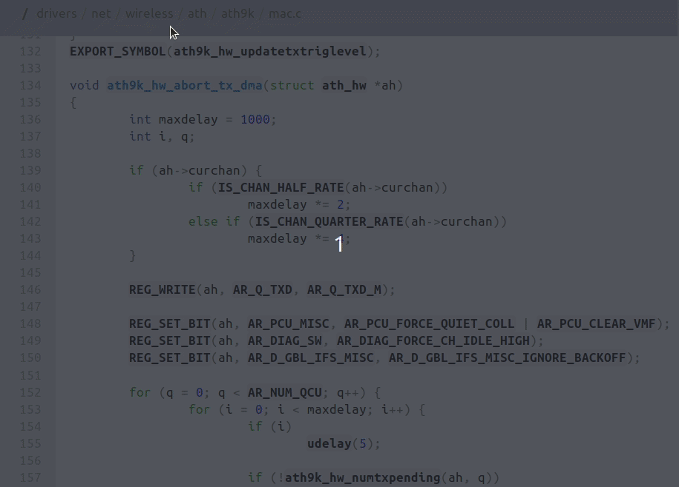
2 Wireless driver
Code Flow:
CCA
CCA Register

Slide 9
3 Kernel module
Linux kernel is Monolithic,
but supports loadable kernel
Object called Module.
Wireless Drivers are loadable!
No need to compile the kernel
to install wireless drivers.
Install/Remove : modprobe
Information : modinfo
Kernel information: dmesg
Module operations.

Slide 10
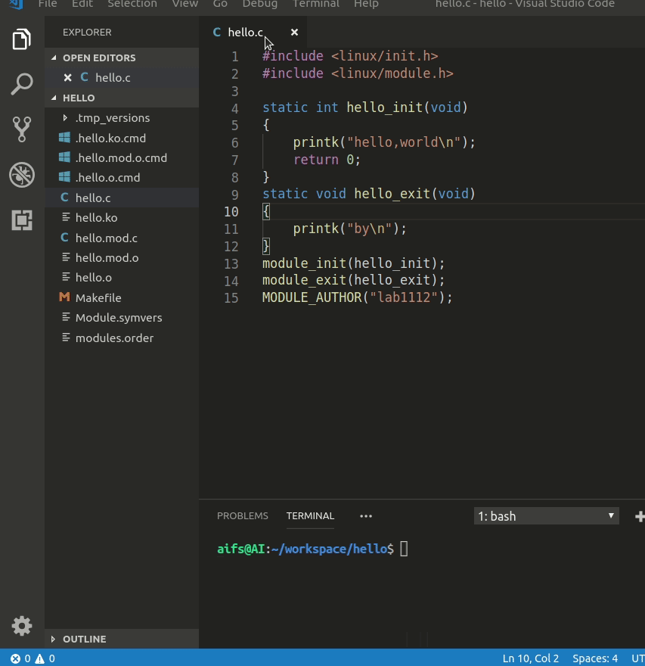
3 Kernel module
Kernel programming:
hello world

Slide 11
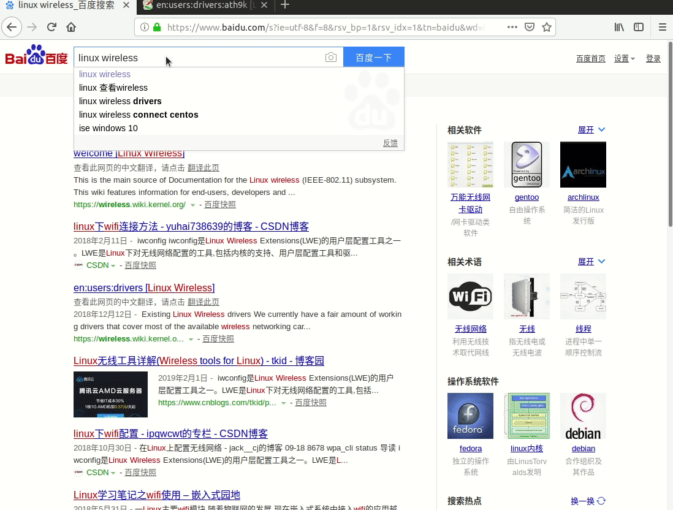
3 Kernel module
Kernel programming:
loadable driver

Slide 12
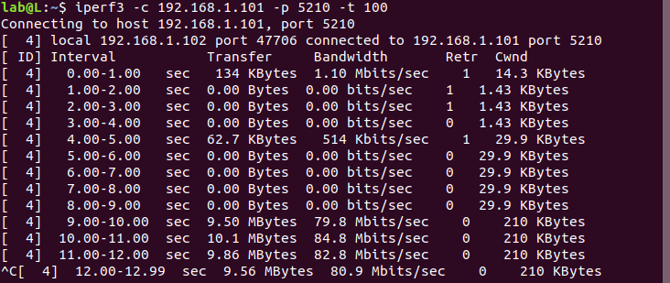
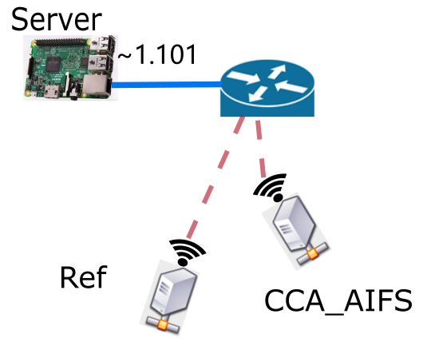
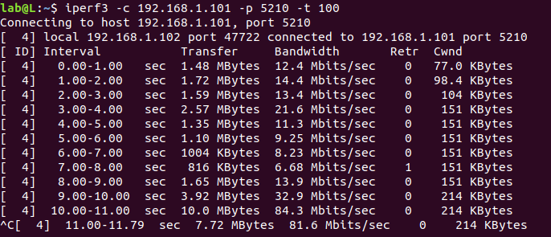
3 Kernel module
Throughput of Ref
Throughput(CCA)
一台主机作为Reference,
设置CCA_AIFS主机的CCA threshold,
两台机子run throughput test,
记录Ref 主机的 throughput.
CCA Modified
Normal

Slide 13
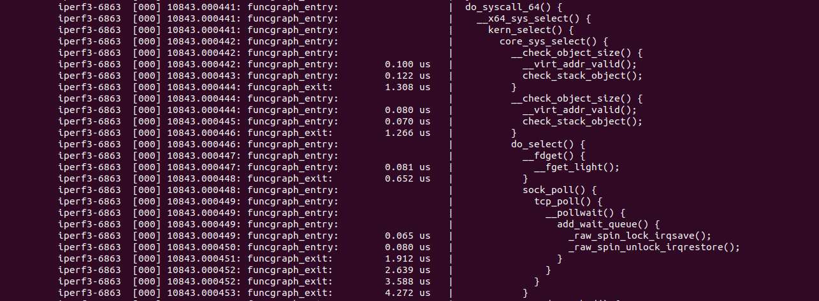
4 Kernel Debugging
What if kernel crashes?
Kernel tracing
trace-cmd, ftrace, eBpf.
Kernel debugging
KGDB,gdb.

Slide 14

THANKS

